Slide 1
Software Engineering Final Presentation
muly - Streaming platform
Group 05

Slide 2
Group Members
Student ID | Student name
20125006 | Nguyen Hoang Khang
20125009 | Ta Quang Khoi
20125081 | Vo Huynh
20125111 | Nguyen Huynh Sang
20125126 | Bui Duy Bao
University of HCMC University of Science
CS300 - Software Engineering
January 2023

Slide 3
Table of contents
01
Problem, Product & Users
04
Analysis
and design
02
Project management
05
Software testing
03
06
Demo
Requirements

Slide 4

Product statement

Slide 5

Problem statement
The problem of | broadcasting non-gaming hobbies (teaching, playing piano…)
affects | any people using and joining to video streaming industry
the impact of which is | people who lack information about what streaming platform they need to use
a successful solution would be | a centralized place for people to showcase their unique talent

Slide 6
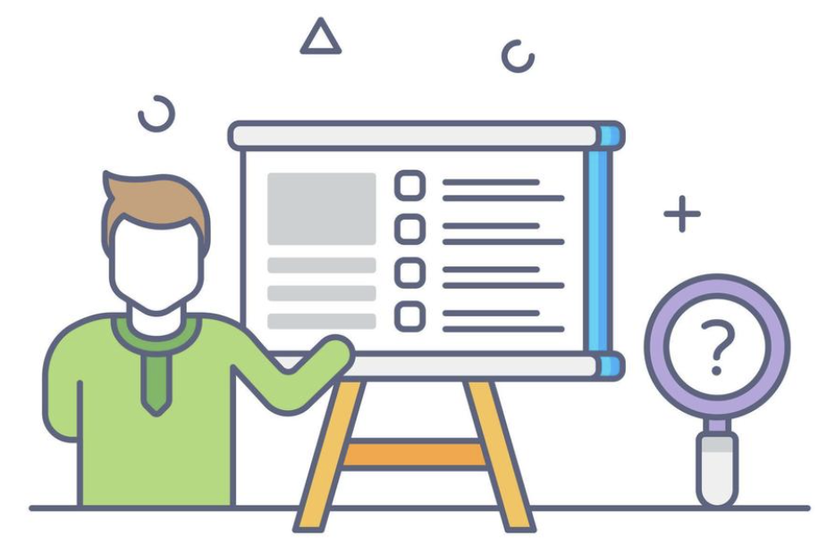
Product position statement
For | content creators, any people with specific hobbies and purposes
Who | wish to broadcast their content and who want to enjoy video streaming
The muly | is a website for multi-purpose live streaming
That | allows the content creator to set up and stream their video to every people in the world
Unlike | the current streaming platform: Facebook, Youtube, Nimo which only focuses on gaming, or focus on other purposes rather than broadcasting
Our product | connects streamers and common people who love to enjoy watching streaming videos.

Slide 7

User Environment
Users need electronic devices which have a microphone, a speaker, and (optionally) a camera and a stable Internet connection (Wi-fi or mobile data).
Our application is completely web-based, as long as your electronic device has internet access, you can fully experience our streaming platform.
The stream can involve multiple users, from many different places. Our application is aimed at the majority of users, whose ages can range from teenagers to adults, they can access the live streams of the people they follow whenever they have time free time.

Slide 8

2. Project management

Slide 9
Team structure
Role | Name
Project manager, Backend Developer | Nguyễn Hoàng Khang
Backend Developer, DevOps | Tạ Quang Khôi
Tester, Frontend Developer | Võ Huỳnh
Backend Developer, Business Analyst | Nguyễn Huỳnh Sang
Frontend Developer, Business Analyst | Bùi Duy Bảo

Slide 10
3. Requirements
03

Slide 11
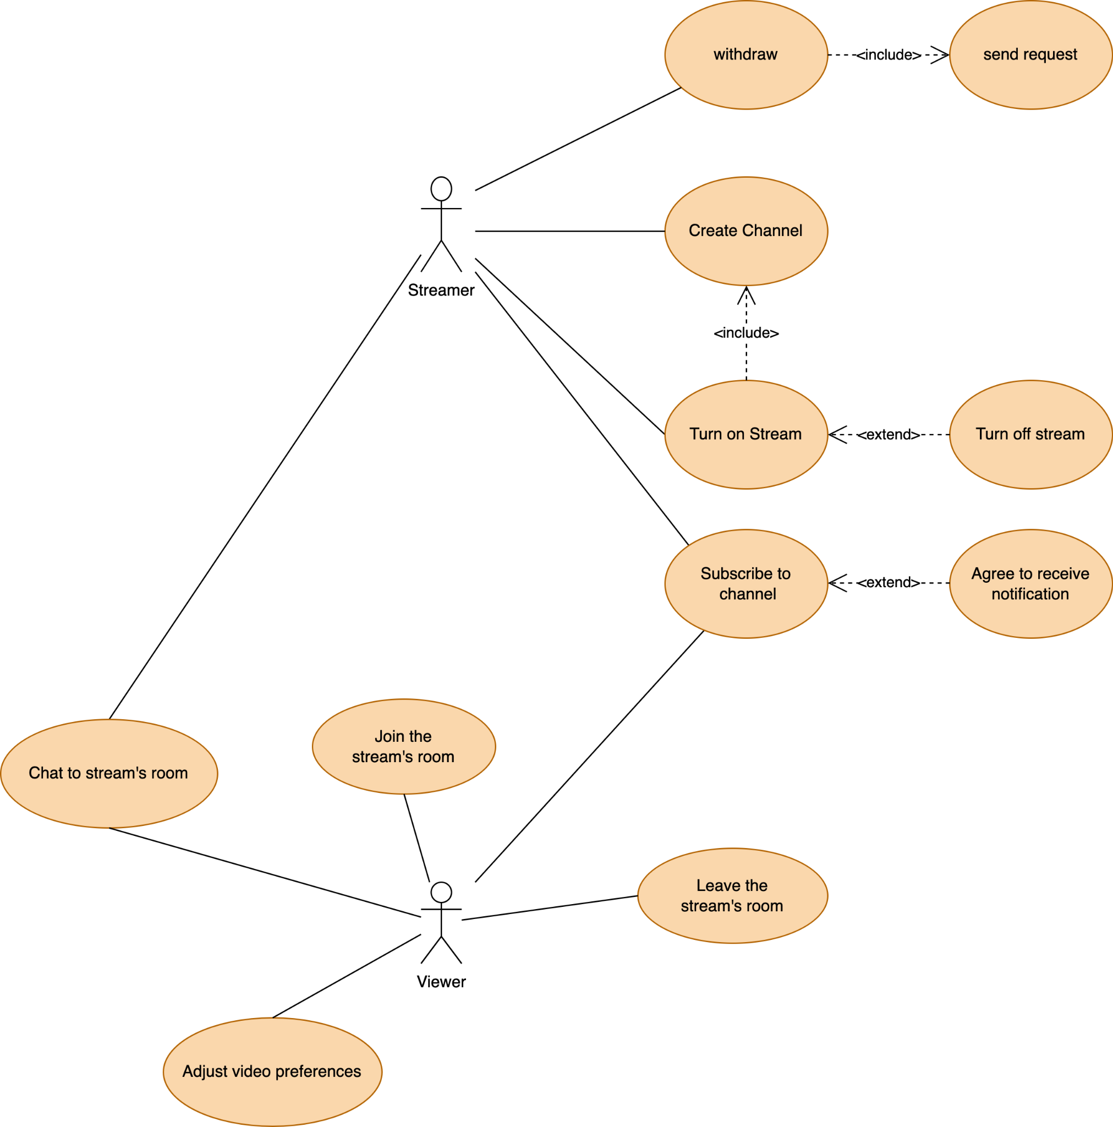
Use-case model

Slide 12
Non-functional requirements
- Average ping should be less than 100ms
- Delay time/video of the stream should be less than 5s.
- Sound quality must be at least 320kbps.
- Number of users at the same time: The video should be viewed by 1 million users at the same time.
- Ensure the security of user information.
- Ensure viewers can securely make payments into the platform.
- Easy for maintainability: Thriving the website maintenance from the initial development means cutting the time & cost to determine and resolve the faults of the system in the future.
- Scalability: It will define how the website can grow and increase its features and functionality without impacting the performance of your website.
- Mobile Responsive
- 3rd Party Integrations: app for payment (Momo, VNPay,...), Youtube stream,...

Slide 13


4. Analysis and Design

Slide 14
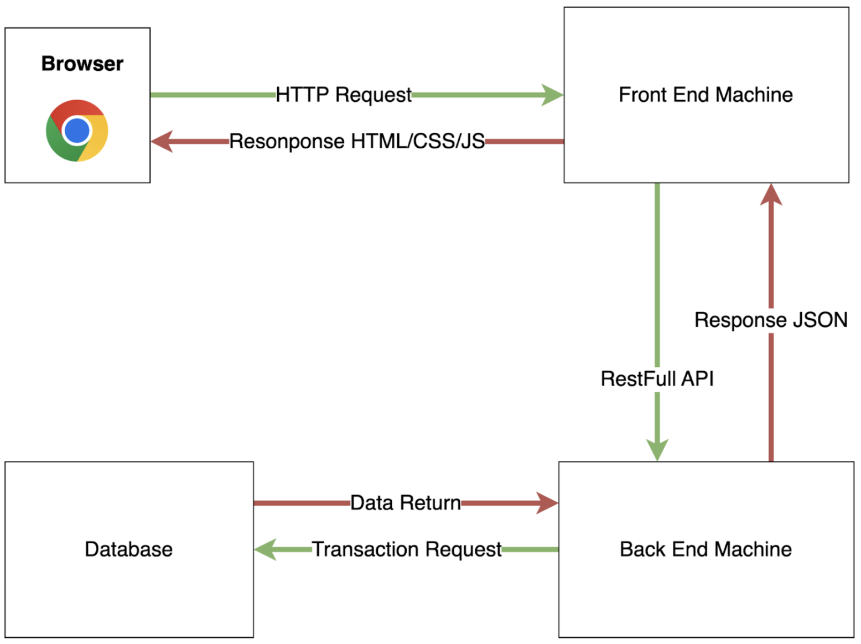
Architecture
Logical View

Slide 15
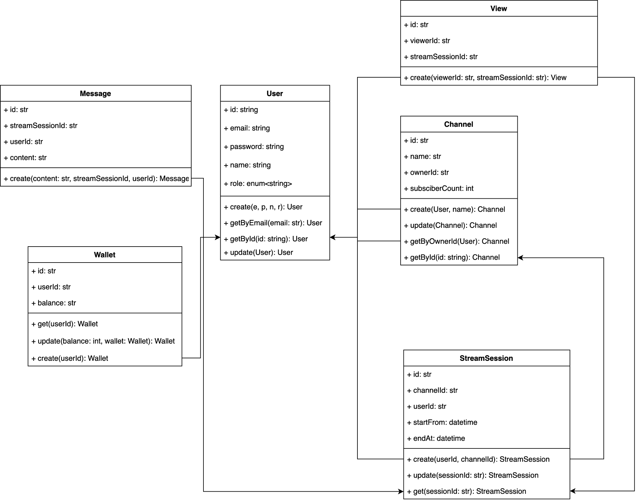
Architecture

Slide 16

Architecture & Technology
We use WebRTC for streaming, we hire a stun server in third party relay.metered
We containerize three sources front-end, back-end, and database into the container by docker.
Deploy frontend into Vercel service, we use EC2 AWS service with port 9000 for back-end and mongo atlas for database.
Client sends a vercel to get HTML/CSS/JS and the front-end code will call port 9000 to execute.server-side stuff.

Slide 17
Technology used
Front-end:
Back-end:
Database:
Deploy frontend in vercel to send CSS/HTML/JS to the browser client whenever they request, frontend will call to port 9000 of backend to request logic processing and data interacting
Backend nestjs will be deployed in port 9000 of EC2 service in AWS web services. Backend will call the Mongodb database to get and update data
We deploy databases into Mongo Atlas service

Slide 18
5. Software testing

Slide 19
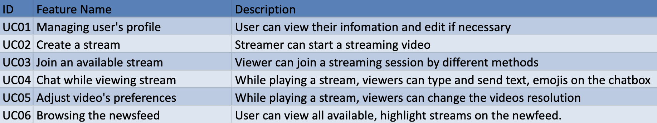

Software testing

Slide 20
5.1. Test environments
Software Name | Purpose | Version | Type and Other Notes
Windows | Operating System | 7+, 32/64 bit
Mac OS | Operating System | Version 10.12+
Chrome | App running environment |  | Internet Browser
Katalon Studio | Automation testing environment

Slide 21
5.2. Test cases

Slide 22
5.3. Test results
Function/Feature ID | Case ID | Test case name | Test step | Test Result | Tester | Tested Date | Status
Function 01: Managing user's profile
UC01 | UI01 | Edit user's information and save, then refresh web | 1. In edit profile tab, edit some information 2. Click SAVE, then refresh (F5) the page | 1. In the edit profile tab, the information changed before is modified successfully. | BDBao | 7/1/2023 | Passed
UC01 | UI02 | Edit user's information but not save, then refresh web | 1. In edit profile tab, edit some information 2. Without click SAVE, then refresh (F5) the page | 1. In the edit profile tab, the information changed before does not modified. | NHSang | 7/1/2023 | Passed
UC01 | UI03 | Edit but not fill the "required" information | 1. In edit profile tab, edit some information 2. In the "required" blank like "username", leave it blank 3. Click SAVE | 1. In the edit profile tab, the system raises error. 2. Scroll back to that missing "require" blank. | NHKhang | 7/1/2023 | Passed
UC01 | UI04 | Fill the username the same as an existing account | 1. In edit profile tab, edit username the same as an existing account's 2. Click SAVE | 1. In the edit profile tab, the system does not raise error | TQKhoi | 7/1/2023 | Failed
UC01 | UI05 | Update password with special characters like: space... | 1. In edit profile tab, at the username blank, input: " " (4 spaces) 2. Click SAVE | 1. In the edit profile tab, the system does not raise error | VHuynh | 7/1/2023 | Failed

Slide 23
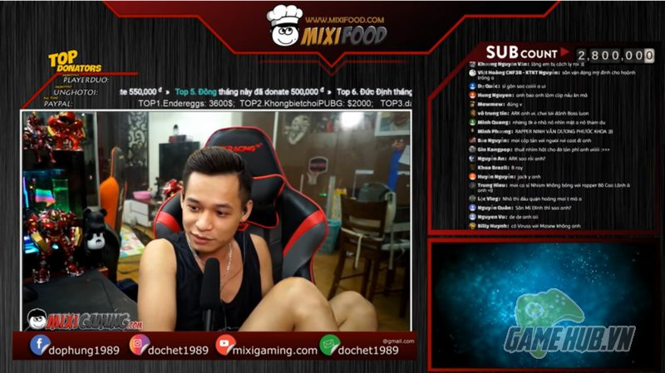
6. Demo
Deployed at:
https://muly-website.vercel.app/

Slide 24


